Slide 1
Equine Disease Surveillance Systems
Drs. Melanie Barham and Alison Moore
CAHSS Equine Workshop
November 3-4, 2016
Toronto, Ontario

Slide 2
Animal Disease Surveillance
Every country in the world has some sort of animal disease surveillance system to:
understand the health status of animals in the country
identify problems quickly and initiate action
Countries have different needs for surveillance
Wealthy countries may focus on protecting trade
Poor countries may only be able to minimize the impact of major diseases
Notes:
INTRODUCTION Every country in the world has some sort of animal disease surveillance system. Surveillance is needed to understand the health status of the animals in the country, so that problems can be identified and actions can be taken. However, different countries have very different surveillance needs and surveillance capabilities: a wealthy country with few diseases that depends on exports of animals and animal products will have sophisticated surveillance systems to protect trade. A poor country with uncontrolled land borders with multiple other countries that have regular outbreaks of epidemic diseases will be unable to maintain sophisticated surveillance systems and will aim primarily at minimising the impact of major animal diseases.
Surveillance systems may be focused at the regional level (eg. province) and nationally with slightly different goals. Tools used for surveillance will also differ greatly between countries. The animal health needs for a horse owner or veterinarian may be different from those working at a national level (production limiting disease )

Slide 3
Why do Surveillance?
Demonstrate freedom from disease
Early detection of disease
Measuring the level of disease
Finding cases of disease
Disease is Absent
Disease is Present
Notes:
The minimum surveillance capabilities that every country should have are relatively simple. The veterinary services should be able to
-describe what important disease are present and
-detect the occurrence of important new, emerging or exotic diseases

Slide 4
Global Surveillance - OIE
OIE (Ordre Internationale Epizootique) - 1924
World Health Organizations for animals
Focus is on mandatory reporting of disease by member countries as well as sharing this information with other countries to reduce the risk of disease spread
Consortium on animal health, conferences, position statements etc
http://www.oie.int/
Notes:
-inter
The main role of international organisations such as the OIE is not simply to receive surveillance reports from member countries, but to share this information with other countries. In this way, when there is a new outbreak of a disease in one country, those countries that are at risk of disease spread (for instance, countries importing animals from the affected country, or closely neighbouring countries) are able to take appropriate steps to limit the risk. The final users of the surveillance information are the countries themselves – the international organisations simply provide a means to communicate this information between countries.
national organisations such as the OIE place emphasis on international reporting on animal health status
The information allows the national veterinary services to make appropriate, well-informed decisions about disease control
he World Organisation for Animal Health (OIE)
The need to fight animal diseases at global level led to the creation of the Office International des Epizooties through the international Agreement signed on January 25th 1924. In May 2003 the Office became the World Organisation for Animal Health but kept its historical acronym OIE.
The OIE is the intergovernmental organisation responsible for improving animal health worldwide.
It is recognised as a reference organisation by the World Trade Organization (WTO) and in 2016 has a total of 180 Member Countries. The OIE maintains permanent relations with 71 other international and regional organisations and has Regional and sub-regional Offices on every continent.
How does the organisation function?
The organisation is placed under the authority and control of a World Assembly of Delegates consisting of Delegates designated by the Governments of all Member Countries. The day-to-day operation of the OIE is managed at the Headquarters situated in Paris and placed under the responsibility of a Director General elected by the World Assembly of Delegates. The Headquarters implements the resolutions passed by the International Committee and developed with the support of Commissions elected by the Delegates:
Council
Regional Commissions (5)
Specialist Technical Commissions (4)
The OIE's financial resources are derived principally from compulsory annual contributions backed up by voluntary contributions from Member Countries.
Contact us: 12, rue de Prony 75017 Paris, France
Tel.: 33 – (0)1 44 15 18 88 Fax: 33 – (0)1 42 67 09 87
Email : oie@oie.int

Slide 5
Regional and Equine Specific Surveillance
DEFRA/Animal Health Trust /British Equine Veterinary Association reports include national and international information
National disease data through laboratory and veterinary practices in the United Kingdom
Collaboration on infectious disease surveillance between countries to inform and alert
Quarterly
Industry level
Worldwide distribution
Some extension articles/factsheets
Through DEFRA, also have text messaging disease alerts
http://www.aht.org.uk/cms-display/DEFRA_AHT_BEVA_equine_reports.html
AHT is financially supported in part from significant contributions from Thoroughbred horse racing in Britain
Notes:
The national disease data is collated through multiple diagnostic laboratories and veterinary practices throughout the united Kingdom, providing a more focussed insight to the prevalence of equine infectious disease. Due to the global mixing of the equine population through international trade and travel, collaboration on infectious disease surveillance between countries occurs on a frequent basis to inform and alert. Both national and international information will be summarised within this report.
AHT
EPIDEMIOLOGY AND DISEASE SURVEILLANCE
Epidemiology is the scientific study of why and how frequently diseases occur in different populations, both animal and human.
Disease surveillance is the continuous monitoring of the occurrence of disease within a population through the collection, collation, analysis and dissemination of disease-related data.
Epidemiological and disease surveillance information are used to plan and evaluate strategies to prevent and control disease, and as a guide to the management of diseases within populations.
Epidemiology and disease surveillance can be used to assist in identifying causes and sources of disease, to identify parts of the population at highest risk of disease and to develop and evaluate disease management programmes.
All of these elements will ultimately lead to improved animal health and welfare, which makes the Epidemiology and Disease Surveillance Department at the Animal Health Trust a vital resource for the veterinary profession in identifying, controlling and preventing disease outbreaks, both nationally and internationally.
Use our menu below to find out more about our epidemiology and infectious disease investigations.

Slide 6
Notes:
Could omit this slide

Slide 7
International Breeders’ Meeting International Collating Centre
Resulted from an equine Viral arteritis outbreak in Kentucky in 1984 which “provoked extensive international reaction”
Wanted to have a reporting system for diseases that have major welfare and economic impacts (EHV-1, EVA, Strangles etc) that is industry sponsored
Organized by the International Breeders Meeting
20 member countries are requested to submit disease reports to the collating centre at the AHT
Each country pays a fee for administrative costs
Reports are provided to the International Federation of Horseracing Authorities and its Internation Movement of Horses Committee, federal veterinarians and national equine industry organizations
Email distribution
http://www.aht.org.uk/cms-display/international-breeders-meeting.html
Notes:
International Collating Centre
An Equine Viral Arteritis (EVA) outbreak in Central Kentucky in 1984 provoked extensive international reaction, including restrictions controlling the movement of horses. As a consequence, it was decided to establish an international reporting system for equine infectious disease that would be industry sponsored. The Office International des Epizooties (OIE) based in Paris was and continues to this day to be responsible for reporting “notifiable” diseases such as African Horse Sickness, Vesicular Stomatitis, and Venezuelan Equine Encephalitis based on information received from federal authorities. There was, however, no reporting system for diseases including equine influenza, EVA, strangles, and equine herpesvirus infections—diseases that have major welfare and economic impacts.
Responsibility for developing the reporting system was undertaken by the International Breeders Meeting (IBM), a consortium of national Thoroughbred breeder organizations that meets approximately every 18 months. The IBM requested its 20 member countries to submit disease reports every three months to a collating center at the Animal Health Trust, Newmarket, England. Each country pays a fee to cover administrative costs and in return receives a quarterly report summarizing the information.
The United States is represented by the Thoroughbred Owners and Breeders Association (TOBA). Dr. David Powell of the Maxwell H. Gluck Equine Research Center has submitted information on behalf of TOBA since the program’s inception in the mid-1980s. Reports are provided to the International Federation of Horseracing Authorities and its International Movement of Horses Committee, federal veterinarians, and national equine industry organizations.
While not without its imperfections, the network has developed a group of knowledgeable veterinarians representing each country who communicate frequently, providing accurate and up-to-date information of disease incidence. By doing so, they play an important part in facilitating the international movement of horses.
CONTACT: Dr. David G. Powell, (859) 257-4757, dgpowe2@uky.edu Maxwell H. Gluck Equine Research Center University of Kentucky, Lexington, Kentucky
top

Slide 8
6. RESPE- France
Developed for horses
Industry funded (TB sales check off)
Breeders and horse owners report abnormal syndromes/clinical signs
Veterinarians report abnormal clinical signs
Smart phone and computer–based platform
Discounted lab fees
Email notification
Mapping
Text messaging services
http://respe.net/
Notes:
Beauty is that vets and owners know about the system
Can report and are aware of the benefits
If they choose to submit to a private lab, government still gets info if reportable etc
Owners and vets share the responsibility of respecting the data
What is the RESPE organisation?
The RESPE network is the first european equine epidemiological and pathological service founded on the basis of a veterinary relay sentry system. In place since 1999, the need of a RESPE service recognised not only by local practitioners, regional, national and international actors of the equine industry, but also it is appreciated by those in charge of health missions in the field. The RESPE comes from voluntary work carried out by the « commission on infectious and parasitical diseases » for the French Equine Veterinary Association AVEF. It has become since the 8th April 2008 an independent service for watching and warning of equine pathological problemsuniting a maximum number of people within the industry.
Objectives of the relay system
The RESPE has four objectives:
1) Insuring a vigilant watch out service for equine illness, in particular those that present important contagious risks and major economical losses or risks to public health. This health surveillance is carried out by four secondary relay services.
2) Development of veterinary knowledge and competences allowing the quick collection of accurate epidemiological information which is quickly transferred to the industry
3) Alerting the health authorities, professional and if needed the public health authorities
4) To manage an equine health crisis other than the government regulated diseases (notifiable) through the creation of a competent cellule
Working of the relay system
More than 550 sentry veterinarians are on the ground insuring the working of the relay. They are voluntary practioners and they cover 92 counties. Their principal daily contribution is to inform the RESPE office of suspiciously contagious illnesses that are being monitored by one or more of the secondary relay services. If there is a suspicion, the veterinary sentry carries out the necessary tests defined in the protocol distributed for each of the secondary relay services. The tests are then sent to a partner laboratory with a standard declaration form, available at the RESPE office or on the RESPE website. The analysis result then arrives at the RESPE office as well as the veterinary sentinels. In a positive case, the RESPE office is notified in the shortest time by telephone or by email. The relay system spreads an anonymous alert to the various contacts to create a warning and eventually to help in any preventive measures. In a case of epizootic the RESPE service insures a reinforced follow up where the illness exists, and regularly informs the industry of the situation, the RESPE service can also help with any research on the ground and can in an extreme crisis create a cellule of specialists to supply needed measures. The RESPE service is also the reporting platform on notifiable diseases, they come in from the official DGAl and DDPP/DDCSPP organisation.

Slide 9
In existence since 1990
Network of active vets in Switzerland reporting disease (EHV, strangles etc)
75 veterinarians from 70 clinics in 14 regions
Estimated 50% coverage of equine population
Vets report clinical signs or laboratory confirmed cases.
Monthly and quarterly reports
Vets can also log in and see maps, details, submission issues
Receive a free CE conference on equine veterinary issues in exchange for participation
Can also receive a rugged smart phone for reporting
Notes:
Helpful in EHV outbreak casuing abortion storm, and druse??
Reporting diseases like Lyme disease, EHV, piroplasmosis, clostridial disease, atypical mypathy, ehrlichia, influenza, strangles
Get an email on the first of the month to remind them to report- asked to confirm “no disease” or disease.
Allows an estimate of prevalence of disease, and can confirm together with laboratory diagnoses
Reporting through an app. If disease alerts arise, can send directly to vet phones.
System is set to alert the Equinella team if there are several clinical signs or a syndrome in an area, and the team gets together to review the information/send an alert.
Welcome to Equinella
The goal of Equinella is the surveillance and early detection of equine diseases through regular reporting of illnesses and symptoms . With Equinella only according epizootic Regulation (TSV) are not notifiable diseases detected. The reportable according TSV epidemics have still officially reported to the cantonal veterinarian / the cantonal veterinarian.
In order to report cases of the disease and symptoms over Equinella, a one-time registration as Equinella-vet or -Tierarzt is required. For security reasons you need a code, with which you can unlock the registry.
identify dangers in advance
The goal of Equinella is the surveillance and early detection of equine diseases through regular reporting of illnesses and symptoms. By systematically evaluating such timely possible messages occurring infectious diseases can be detected at an early stage and therefore appropriate measures to protect the horse population will be taken in time. This is far more important, because the horses in Switzerland is becoming increasingly important. Many horse owners have equestrian events or the purchase of animals, semen or embryos intensive contacts abroad. There is therefore a serious risk for the introduction of equine diseases.
To this hazard counter, it needs not only a good observation of the animals by animal keepers and veterinarians as well as efficient diagnosis, but also a powerful reporting system.
Additional information : Equinella Flyer
Syndrome Surveillance
The timely, comprehensive possible reporting of certain symptoms such as fever or anemia to a central location helps an infectious events respectively. early detection of an outbreak of an already known, or else a new disease. Subscribe for example in a region several Equinella-veterinarians and veterinarians independently the same symptom that Equinella team can keep up with this consultation and inform the concerned parties that propagates a potentially contagious disease in this region. First measures to prevent the spread of the disease thus can already be taken before concrete laboratory results are available. If in the region an event is planned, the organizers may also be forewarned. A temporal and / or spatial clustering of certain nonspecific symptoms without specific diagnosis but may also be an indication of a new, previously unknown disease. In such a situation can be consulted can be operated to move the cause of the incident by experts. Syndrome Surveillance brings but only slightly, if the greatest possible coverage of the horse population is given by a system like Equinella;that is, when as many veterinarians participate.
Not notifiable diseases
With Equinella only according epizootic Regulation (TSV) are not recorded notifiable diseases. All reportable according TSV diseases must be formally reported to the cantonal veterinarian / Canton vet as before.
List of notifiable animal diseases of horses (source: BLV)
added value
Since the re-launch of Equinella registered veterinarians have the possibility of illness and symptoms to report online. The heart of this is a user-friendly online platform with which messages via computer and smartphone can be done.
With Equinella only according epizootic Regulation (TSV) are not recorded notifiable diseases. All according TSV notifiable diseases have been officially reported as the canton veterinarian / the cantonal veterinarian .
The electronically transmitted data are recorded in a central database and evaluated regularly by the Equinella-Unit. The latest reports are switched anonymously on the public side and are visible both for veterinarians, animal keepers and pet owners as well as for the horse industry and other interested parties. Equinella as a central reporting and information platform thereby provides valuable information about the current equine health situation in Switzerland and strengthens the disease and disease awareness among the general public.
More value for Equinella-veterinarians and veterinarians
Regular feedback reported by the Equinella-veterinarians and -Tierärzten data are evaluated anonymously by the Equinella-Unit. The veterinarians regularly receive an overview and exclusive information on the current situation of equine diseases and symptoms reported in Switzerland in the form of a newsletter and in public areas of Equinella website.
SMS Alarms When a disease outbreak all registered Equinella-veterinarians and veterinarians will be alerted via SMS about what is happening.
Expert advice In observation of unusual events can be by telephone and / or email to advise of an expert of Equinella teams the Equinella-veterinarians and veterinarians. The Equinella team has a broad network of contacts with international experts.
Annual training once a year will be organized a training session, which deals with current topics in equine medicine. For Equinella-veterinarians and veterinarians participation is free. The training is recognized by the SVPM.
Laboratory tests subsidizing laboratory tests provided the medium term. Terms for the activity of Equinella-vet and -Tierarzt
More value for the horse industry and other stakeholders
In addition to the veterinary profession also get the Swiss horse industry and other stakeholders a large value through Equinella. The anonymous representation of disease reports in the public area of ​​the website provides Equinella the horse industry a reliable overview of the current situation of horses infectious diseases in Switzerland. Such information is relevant essential for the early detection of disease outbreaks and both equestrian and breeding associations. The horse industry organizations can also benefit from the broad international network of Equinella. Animal keepers and pet owners are informed by Equinella also better than local disease process and breakouts and are sensitized.

Slide 10
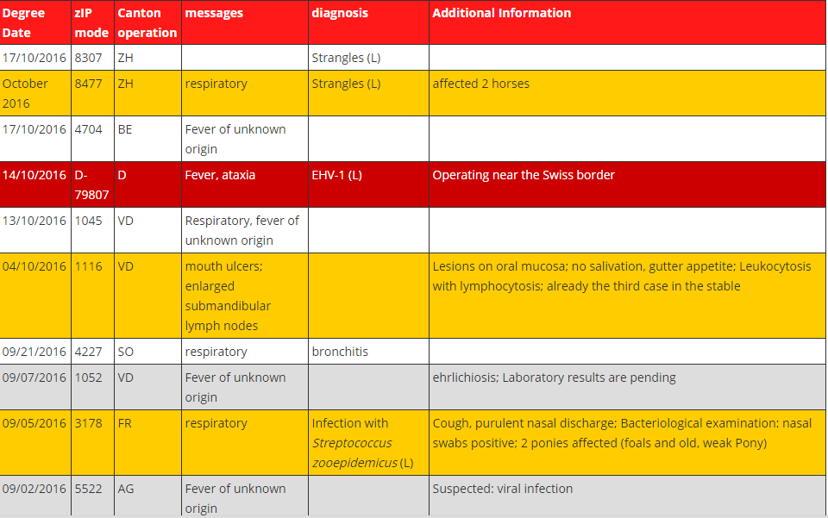

Slide 11
NEW!
The Equine Disease Communication Center works to protect horses and the horse industry from the threat of infectious diseases in North America
Reports real time information online about disease outbreaks to help mitigate and prevent spread of disease
As part of the National Equine Health Plan in the US , the EDCC will help educate and promote research about endemic and foreign disease
Works with state animal health officials and the USDA
Only posts confirmed cases
Provides Email alerts
Funded by industry and AAEP
http://www.equinediseasecc.org/
Notes:
WHAT IS THE EDCC
The Equine Disease Communication Center (EDCC) works to protect horses and the horse industry from the threat of infectious diseases in North America. The communication system is designed to seek and report real time information about disease outbreaks similar to how the Centers for Disease Control and Prevention (CDC) alerts the human population about diseases in people.
The goal of the EDCC is to alert the horse industry about disease outbreak information to help mitigate and prevent the spread of disease. Ultimately frequent and accurate information about diseases outbreaks improves horse welfare and helps to prevent negative economic impact that can result from decreased horse use due to a fear of spreading infection. As part of the National Equine Health Plan the EDCC will serve as part of the communication to help educate and promote research about endemic and foreign disease.
Working in cooperation with state animal health officials and the United State Department of Agriculture, the EDCC seeks information about current disease outbreaks from news media, social media, official state reports and veterinary practitioners. Once information is confirmed, it is immediately posted on this website and messages sent to all states and horse organizations by email. Daily updates are posted until each outbreak is contained or deemed no longer a threat.
The EDCC is made possible by generous donations from organizations and horse owners. Please visit our sponsors that have generously supported this program for the benefit of the health and welfare of horses. To learn how you can help go to SUPPORT

Slide 13
Canada – National CFIA
Animal Disease surveillance supports Canada’s ability to recognize and deal with emerging animal disease problems
Plays a role in providing Canadian livestock access to more markets
EIA testing program
Import export guidelines
Risk assessments, industry consultation
Rabies reporting
OIE reporting
Receives periodically and immediately notifiable disease reports from laboratories and provinces
Notes:
Terrestrial Animal Disease Surveillance
Animal disease surveillance supports Canada's ability to recognize and deal with emerging animal disease problems. Surveillance also plays an import role in providing Canadian livestock and poultry products access to more markets.
The Canadian Food Inspection Agency's surveillance activities are supported by:
a nationwide network known as Canadian Animal Health Surveillance Network (CAHSN), which draws on the disease detection capabilities of practising veterinarians, provincial and university diagnostic laboratories and the federal government;
animal identification programs which help trace disease outbreaks to their source.

Slide 14
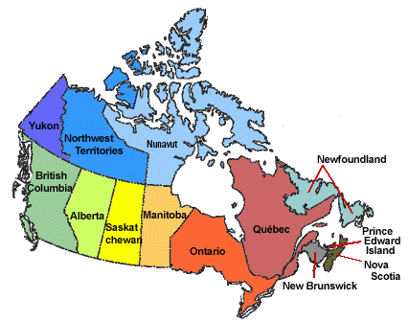
Provincial governments
Receive positive test results regarding immediately and periodically notifiable diseases from the laboratories
Extension veterinarians provide support, education and information to veterinarians and industry
Staff perform risk assessments, coordinate a response if needed and support communications to the industry
Individual provinces have different legislation regarding animal disease surveillance
Individual provincial governments vary in the strength or their relationship with industry and stakeholders

Slide 15
British Columbia Equine Disease Reporting
New!
To help protect BC’s horses, the Animal Health Centre at the BC Ministry of Agriculture launched a webpage devoted to equine disease reporting
B.C. Equine Disease Surveillance & Report
Online reporting of equine disease, verified by laboratory testing
Reportable, notifiable and non-reportable, non-notifiable diseases are posted
Goal is to increase and facilitate communication with current and reliable reporting for veterinarians, horse owners and other stakeholders to help inform and educate
The program is a cooperative information sharing partnership between the B.C .government and veterinarians practicing in B.C.
http://www2.gov.bc.ca/gov/content/industry/agriculture-seafood/animals-and-crops/animal-health/reportable-notifiable-diseases/equine-disease-report
Notes:
B.C. Equine Disease Surveillance & Report
To help protect BC’s horses the Animal Health Centre at the BC Ministry of Agriculture has launched a webpage devoted to equine disease reporting: B.C. Equine Disease Surveillance & Report. The timely reporting of accurate information about disease outbreaks allows owners to make informed decisions, improves horse welfare and helps to mitigate the potential for serious financial loss to the industry.
The goal is to increase and facilitate communication with current and reliable reporting for veterinarians, horse owners and other stakeholders to help inform and educate.
This “Surveillance and Report” program is a cooperative information sharing partnership between the B.C. government’s Animal Health Centre and veterinarians practicing in B.C. Verified diagnostic information regarding the occurrence of reportable, notifiable and non-reportable/notifiable diseases will be posted in the B.C. Equine Disease Surveillance & Report. At this time there isn’t an email alert system in place so check the website for information.
B.C. Equine Disease Surveillance & Report
Mission
To communicate the status of reportable and notifiable equine diseases in B.C. To also communicate the status of equine non-reportable and non-notifiable diseases at the discretion of equine veterinarians. This information is intended for veterinarians, horse owners and other stakeholders in the provincial equine industry.
How the surveillance program works
The program is a cooperative information sharing partnership between the B.C. government's Animal Health Centre and veterinarians practicing in B.C. Verified diagnostic information regarding the occurrence of reportable, notifiable and non-reportable/notifiable diseases will be posted below in the B.C. Equine Disease Report.
Diseases to be communicated in the report:
Non-reportable and Non-notifiable Diseases: To post a diagnosis of a non-reportable, non-notifiable disease on this site, the veterinarian will contact the page manager at 1-800-661-9903 with the clinical and diagnostic information for the case. The manager will upload the case to the Equine Disease Report and will follow the case with the veterinarian to resolution. Updates to the case will be added to the Equine Disease Report as warranted.
Reportable and Notifiable Diseases: These diseases prescribed under the Animal Health Act are mandatory to report to the Chief Veterinary Officer of B.C. upon diagnosis. After a reportable or notifiable disease is reported, the Chief Veterinary Officer will inform the page manager of the diagnosis for posting in the disease report below. To see a list of all equine reportable and notifiable diseases, please click the headings.

Slide 16
Notes:
Could remove

Slide 17
Alberta
Office of the Chief Veterinarian – reportable diseases and extension
EHV-1 outbreak handled through collaboration between University of Calgary, Alberta Veterinary Medical Association, Alberta Equestrian Federation and other industry stakeholders

Slide 18
Saskatchewan
Chief Veterinary Officer contact for reportable diseases
Extension services
Equine tick surveillance
A research project conducted by the Western College of Veterinary Medicine, University of Saskatchewan
Saskatchewan Horse Federation and Western College of Veterinary Medicine – EIA testing
Notes:
FROM WENDY WILKINS
Note: we don’t conduct surveillance, but EHV, WNV and rabies are immediately notifiable diseases in Saskatchewan and we receive reports from labs/vets when these diseases are confirmed.
We monitor EIA submissions to PDS, and supported some targeted surveillance/EIA testing at comingling sites that would agree to be EIA test negative sites going forward. This did result in increased EI tesing and in some under-represented parts of the province.

Slide 19
Quebec RAIZO
In Quebec for 22 years
Group of 6-7 equine veterinarians from different regions of Quebec with faculty members of the University of Montreal
Objectives:
to promote the detection and timely reporting of disease that may affect equine or public health
Recommend health management to control disease
Effective dissemination of relevant information to vets and the industry
Survey of veterinarians and laboratory data are used as surveillance data
Reports are sent to industry partners
http://www.mapaq.gouv.qc.ca/fr/Productions/santeanimale/maladies/RAIZO/Pages/reseauequin.aspx
Notes:
Objectives
Promote detection and reporting quick situation abnormal or may affect the equine livestock health or public health : disease emerging or in resurgence, atypical clinical picture, etc.
Recommend the implementation of health measures or management of livestock to prevent or control health problems.
Effective dissemination of relevant information to doctors veterinary practitioners and partners of the equine industry.
Contribute to the dynamism of the equine industry, particularly in promoting the integration of a component animal health and public health at the heart of the partner organizations.
Members of the network
Veterinary doctors of MAPAQ animate the network while ensuring the coordination of activities and by providing expertise in veterinary microbiology and animal pathology.
Veterinary medical sentries of the Faculty of veterinary medicine (FMV) of the University of Montreal and the different regions of Quebec contribute to the activities of the network and offer their expertise.
Reporting
Veterinarians or partners of the RAIZO
If you see a situation that could endanger the health of livestock or public health, made a report according to either of the following options:
Contact the Sentinel surveillance Network Manager
Operation
Meetings and Conference calls allow Exchange on equine health and a picture of the situation of the major diseases.
Veterinary medical practitioners are invited to report any abnormal or situation likely to affect public health or equine livestock health network. Surveillance is also supported by data collected by MAPAQ's animal health laboratories and the service of diagnosis of the FMV.
Surveillance data are analysed by the members of the network. The relevance of follow up as well as to put in place health measures or appropriate management is then evaluated. Information from the activities of the network are distributed to the partners and individuals.

Slide 20
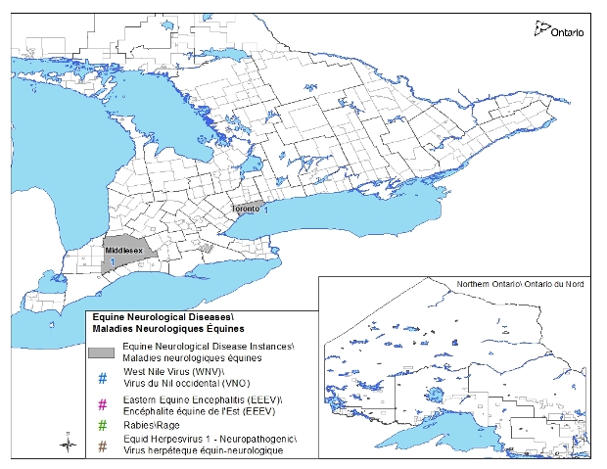
Ontario
OMAFRA
Animal Health Act
Map equine neurological disease (EHV-1, EEE, WNV, Rabies) http://www.omafra.gov.on.ca/english/livestock/horses/facts/nhd_surv2015.htm
Ontario Animal Health Network
Private equine vets are surveyed quarterly
8 equine veterinarians meet quarterly to discuss survey results, laboratory results and create reports for veterinarians and industry
Includes syndromic surveillance
www.oahn.ca

Slide 21
Other surveillance activities
Veterinary colleges- research programs
Agricultural colleges- research programs
Worms and Germs map http://www.wormsandgermsmap.com/
IDEXX mapping for dogs and cats (Lyme, anaplasma, ehrlichia) http://www.dogsandticks.com/map/2012/
Public health mapping

